Slide 1
Research Abroad Collaboration Diagram
Group – 5
1905074,1905076, 1905085,1905107,1905116,1905117,1605068
Presented by – Fahad Ahmed

Slide 2
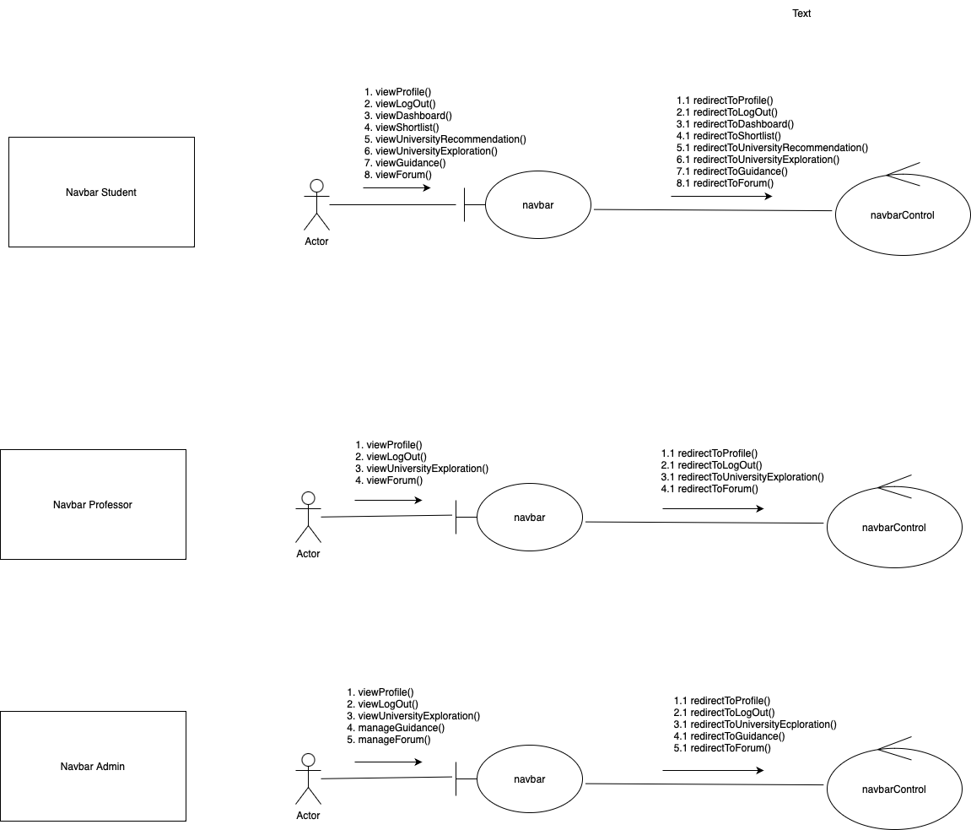
Navbar

Slide 3
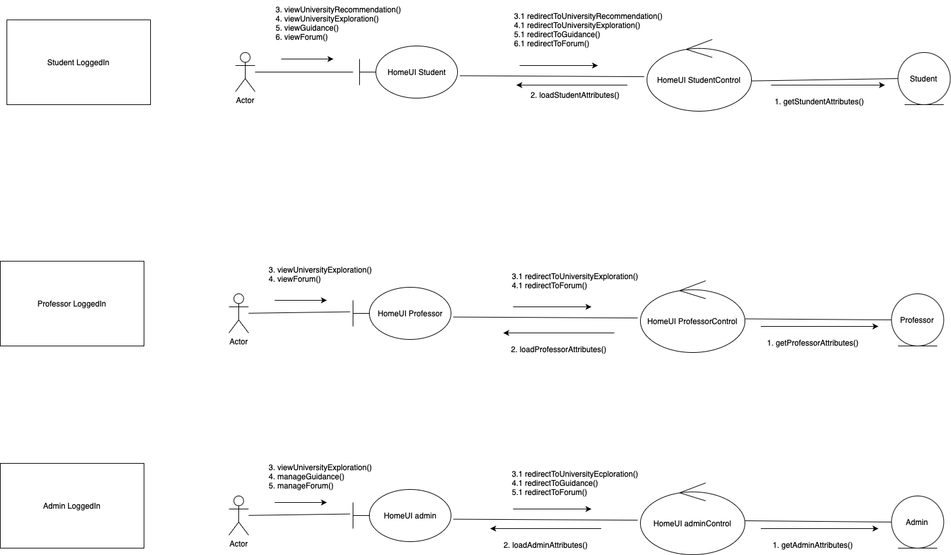
Logged In Page

Slide 4
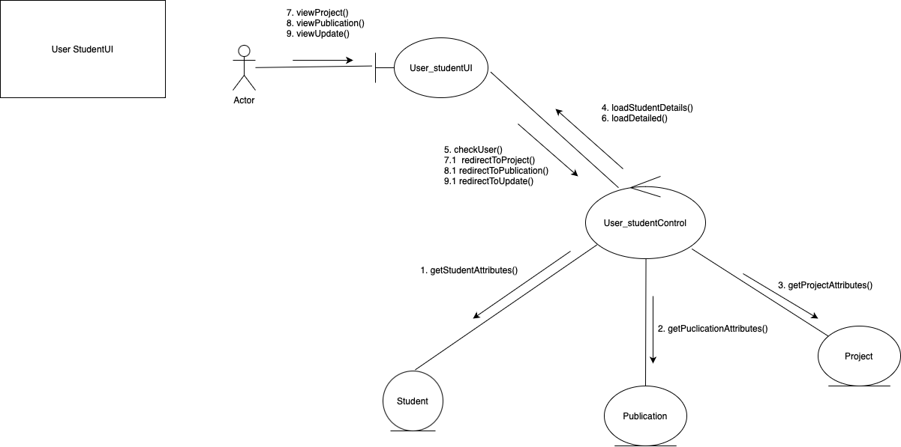
Student Profile

Slide 5
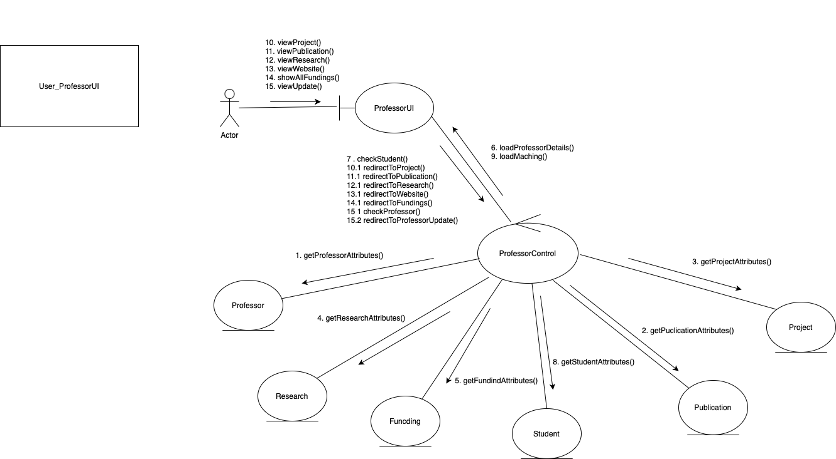
Professor Profile

Slide 6
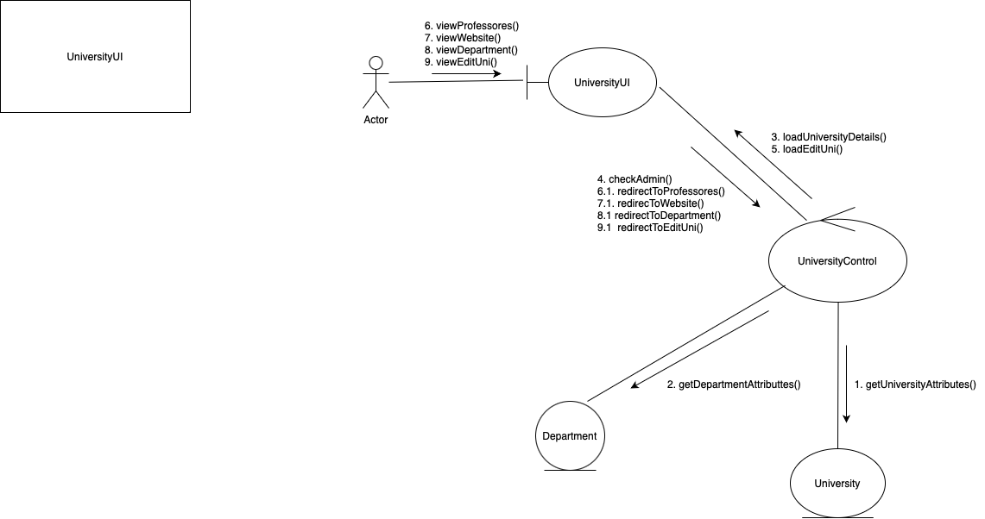
University Profile

Slide 7
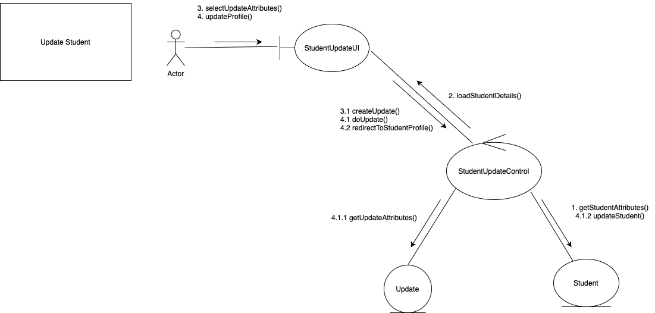
Student Update

Slide 8
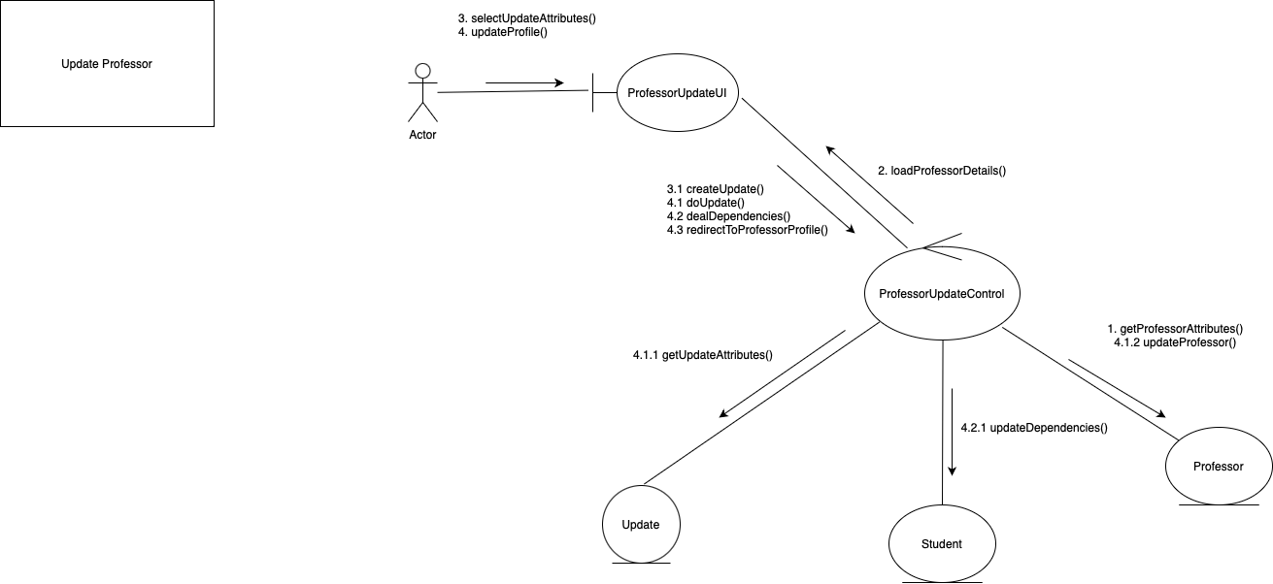
Professor Update

Slide 9
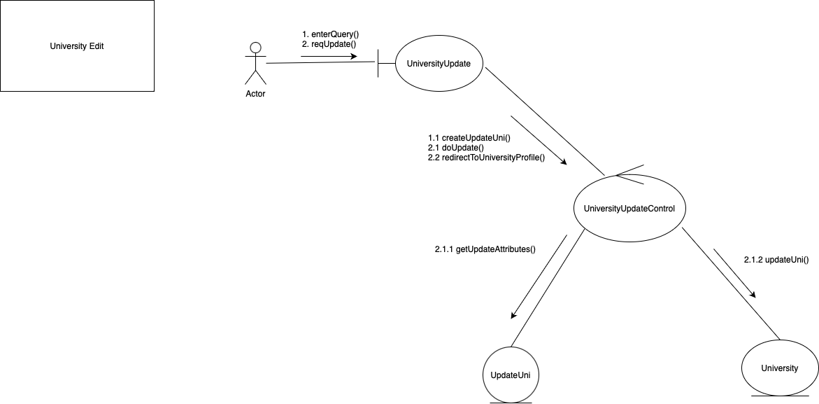
University Info Update

Slide 10
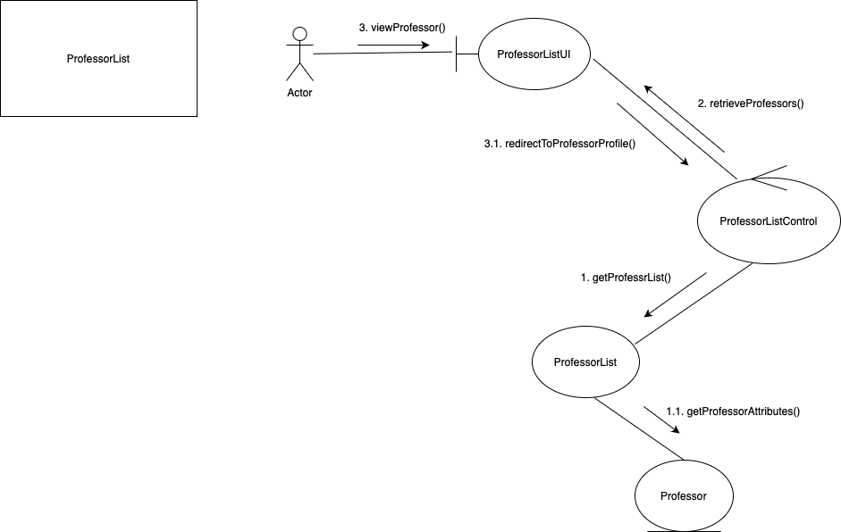
Professors’ List

Slide 11
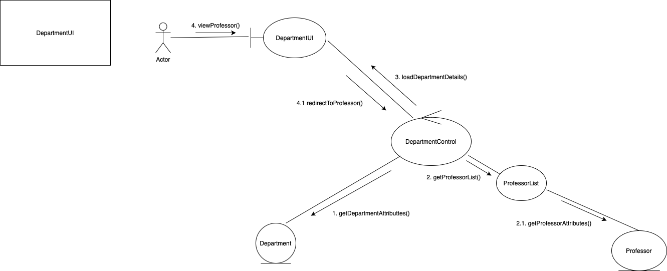
Department

Slide 12
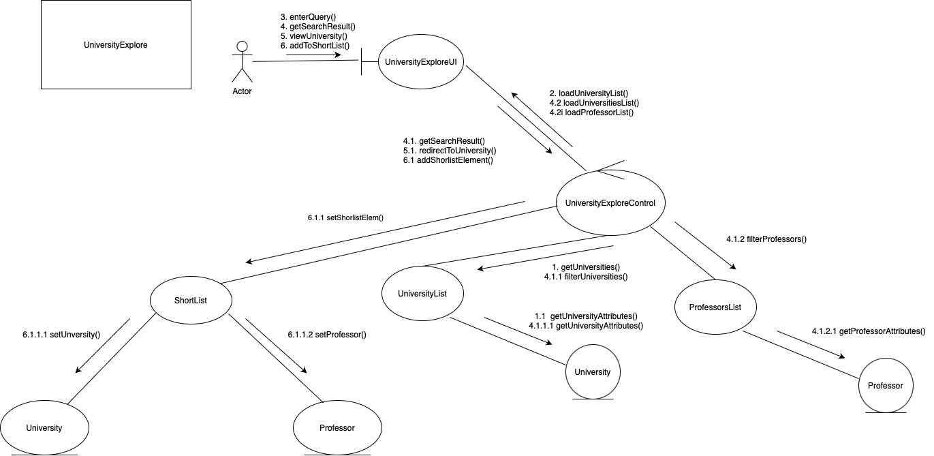
University Explore

Slide 13
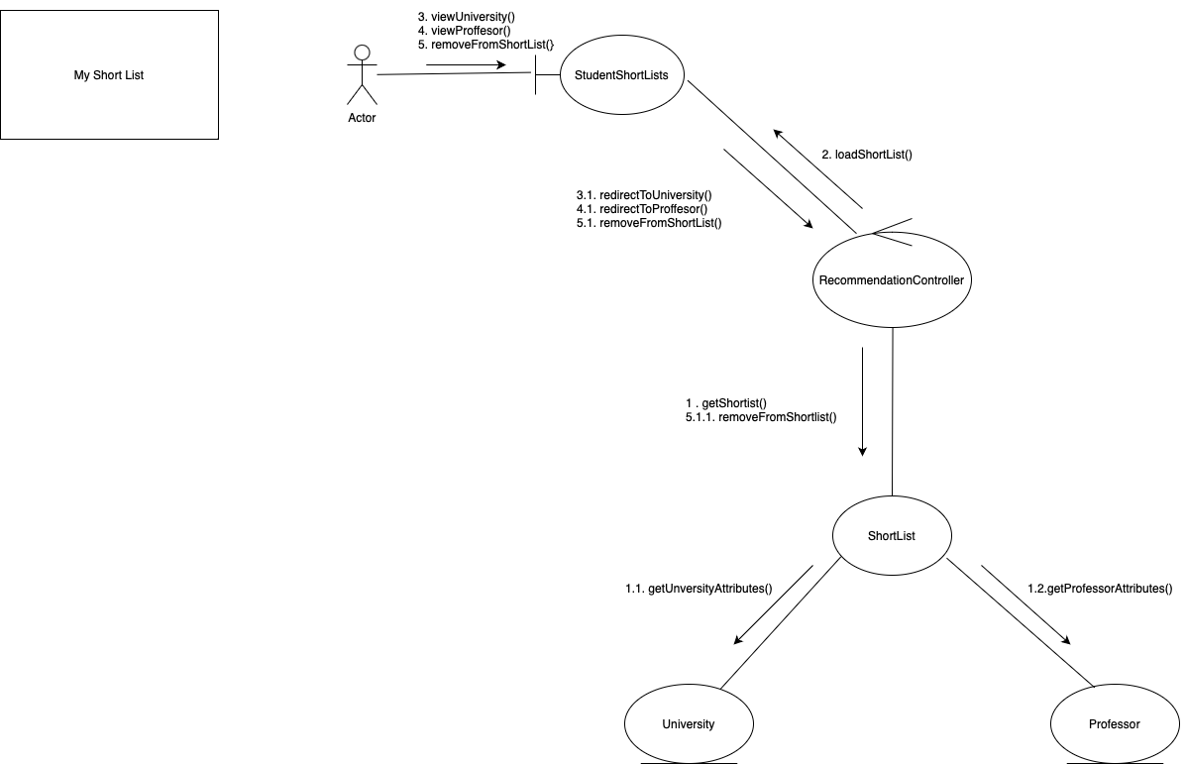
My Shortlist

Slide 14
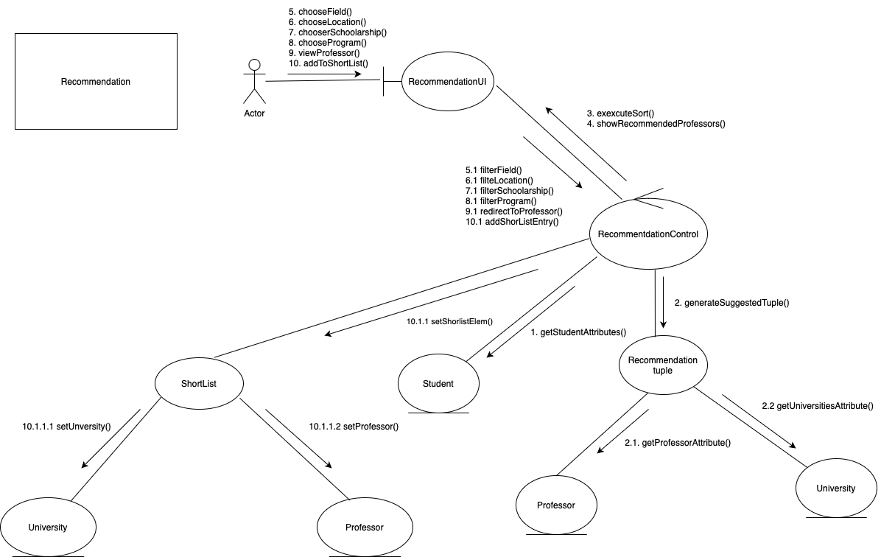
Recommendation

Slide 15
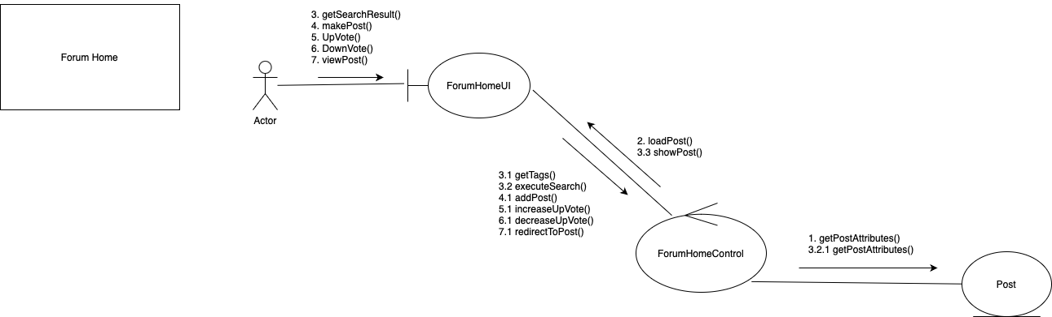
Forum (Home)

Slide 16
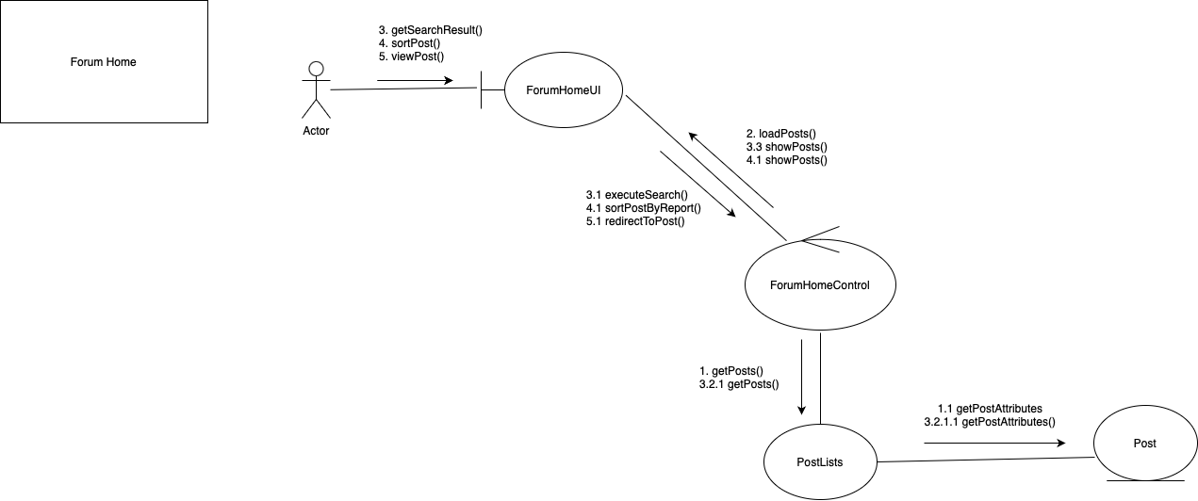
Forum (Admin)

Slide 17
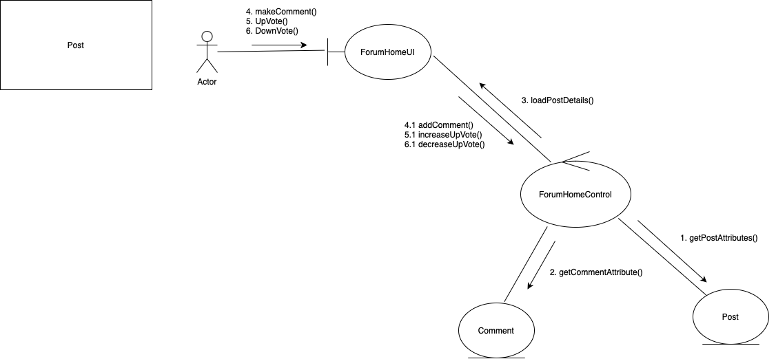
Post

Slide 18
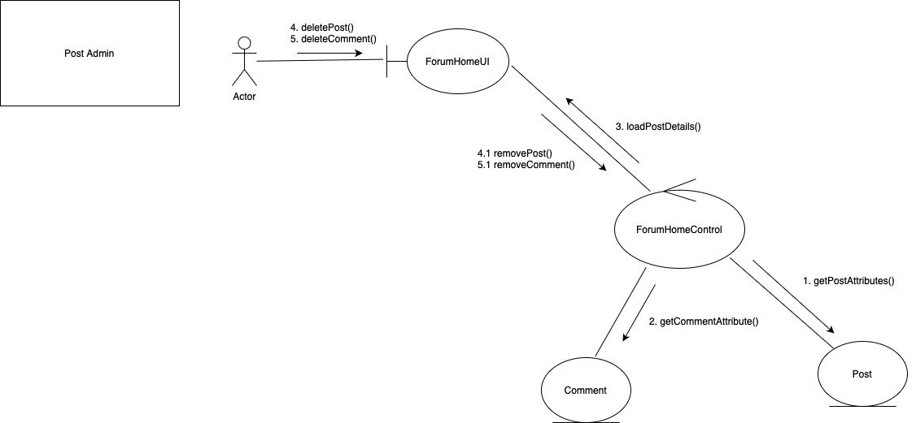
Post (Admin)

Slide 19
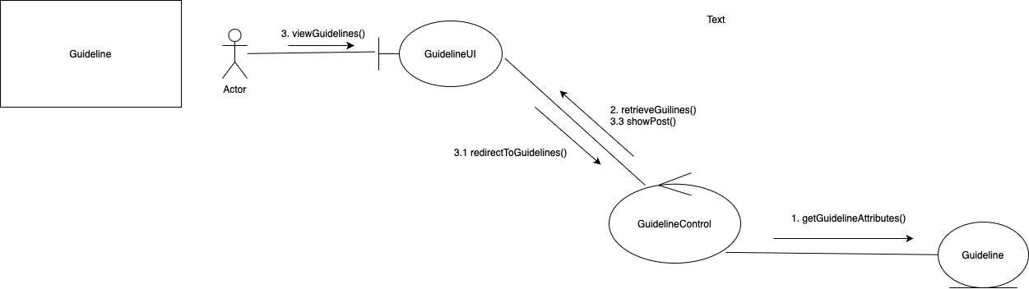
Guidelines

